Slide 1
Census Data Analysis using Big Data Technology
prepared by:- Annu Sharma

Slide 2
Content
The Context : Big Data
What is Big Data
Big Data Use Cases
Characteristics Of Big Data
Hadoop Eco-System
Importance of Big Data Solutions
Project Outline
Architectural Diagram
Hardware and Software Requirements
Job1
Job2
Job3
Job4
Questions
Thankyou

Slide 3
The Context : Big Data
Man on the moon with 32KB (1969); my laptop had 2GB RAM (2009)
Google collects 270PB data in a month (2007), 20000PB a day (2008)
New York Stock exchange generates huge amount of data in a day
Data mining huge amounts of data collected in a wide range of domains from astronomy to healthcare has become essential for planning and performance.
We are in a knowledge economy.
Data is an important asset to any organization (Social, Retail, Transport, Technology)
Discovery of knowledge; Enabling discovery; annotation of data
Business Success Heavily depends upon
Ability to store and process huge amount of data
We are looking at newer
programming models, and
Supporting algorithms and data structures.

Slide 4
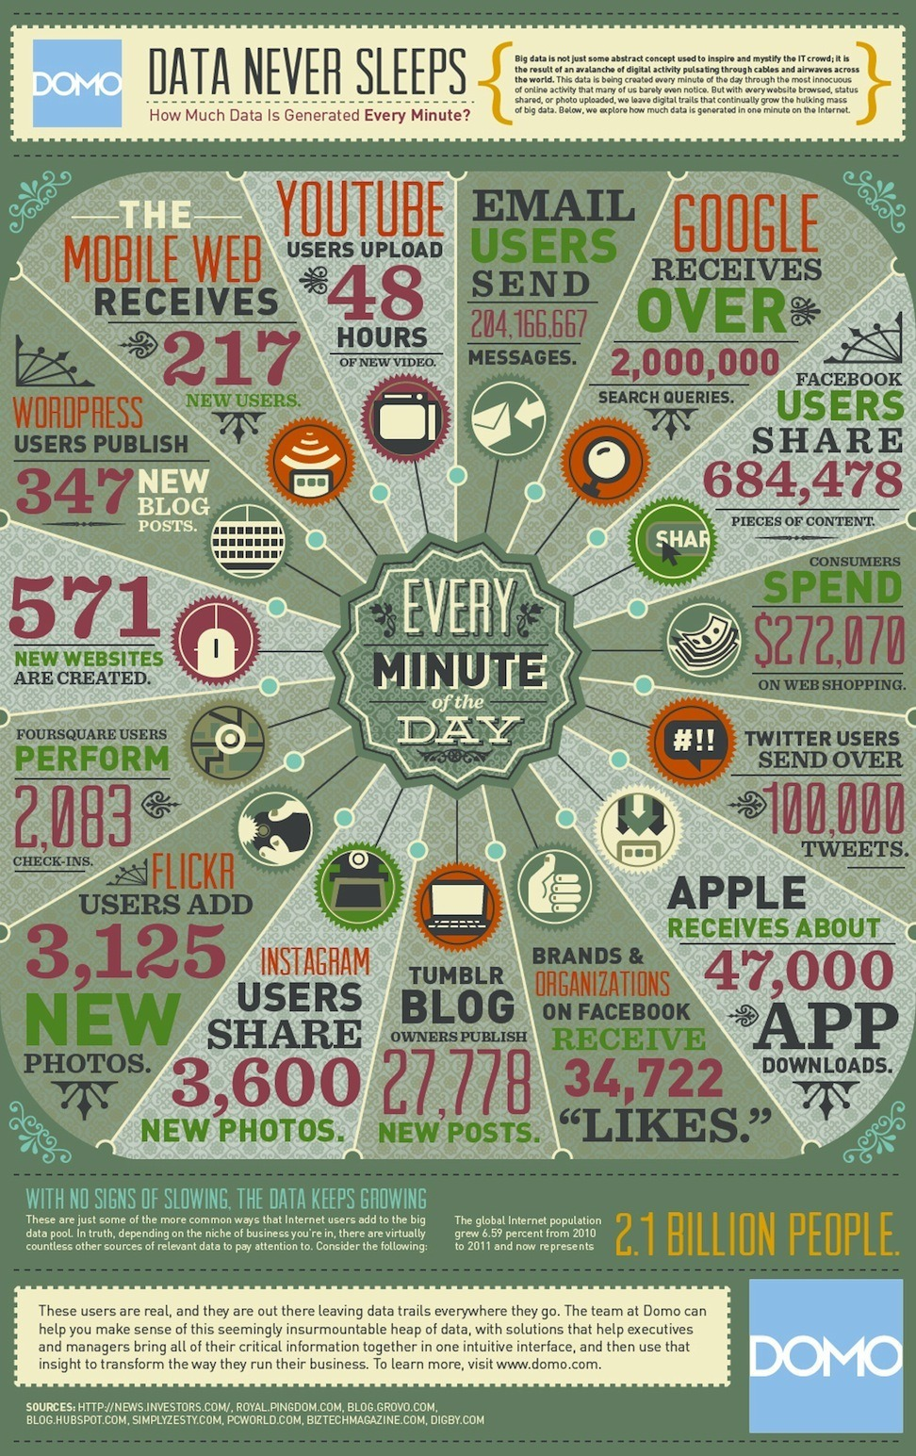

Slide 5
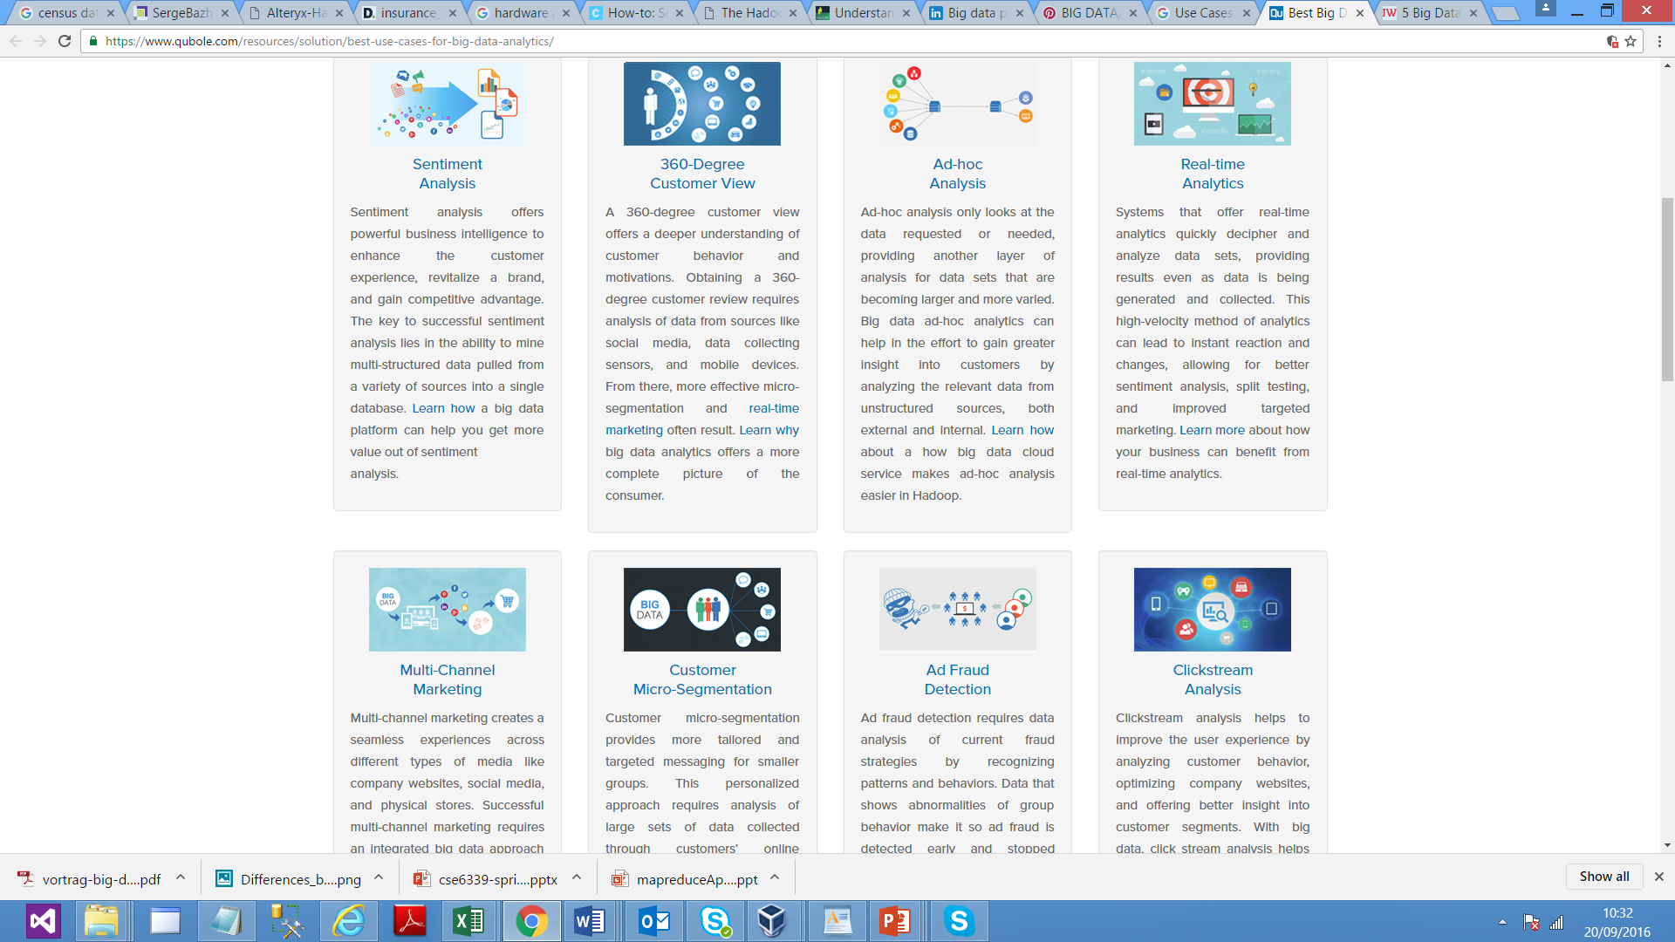
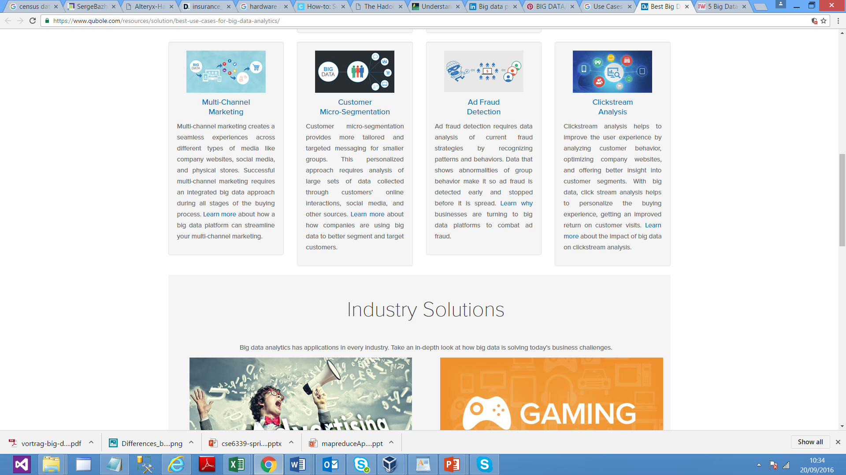

Big Data Use-Case

Slide 6
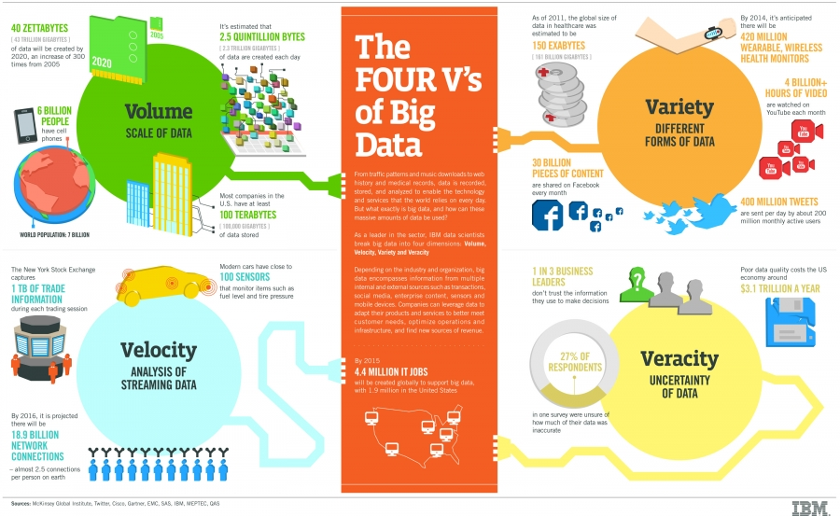
Characteristics Of Big Data

Slide 7
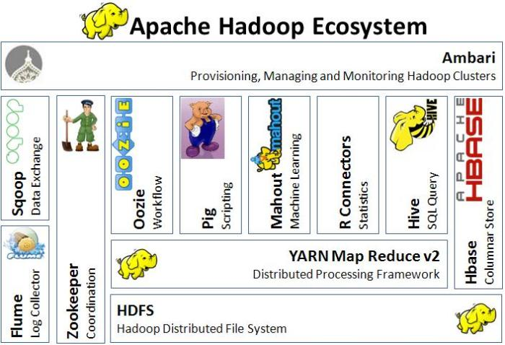
Hadoop Eco-System

Slide 8
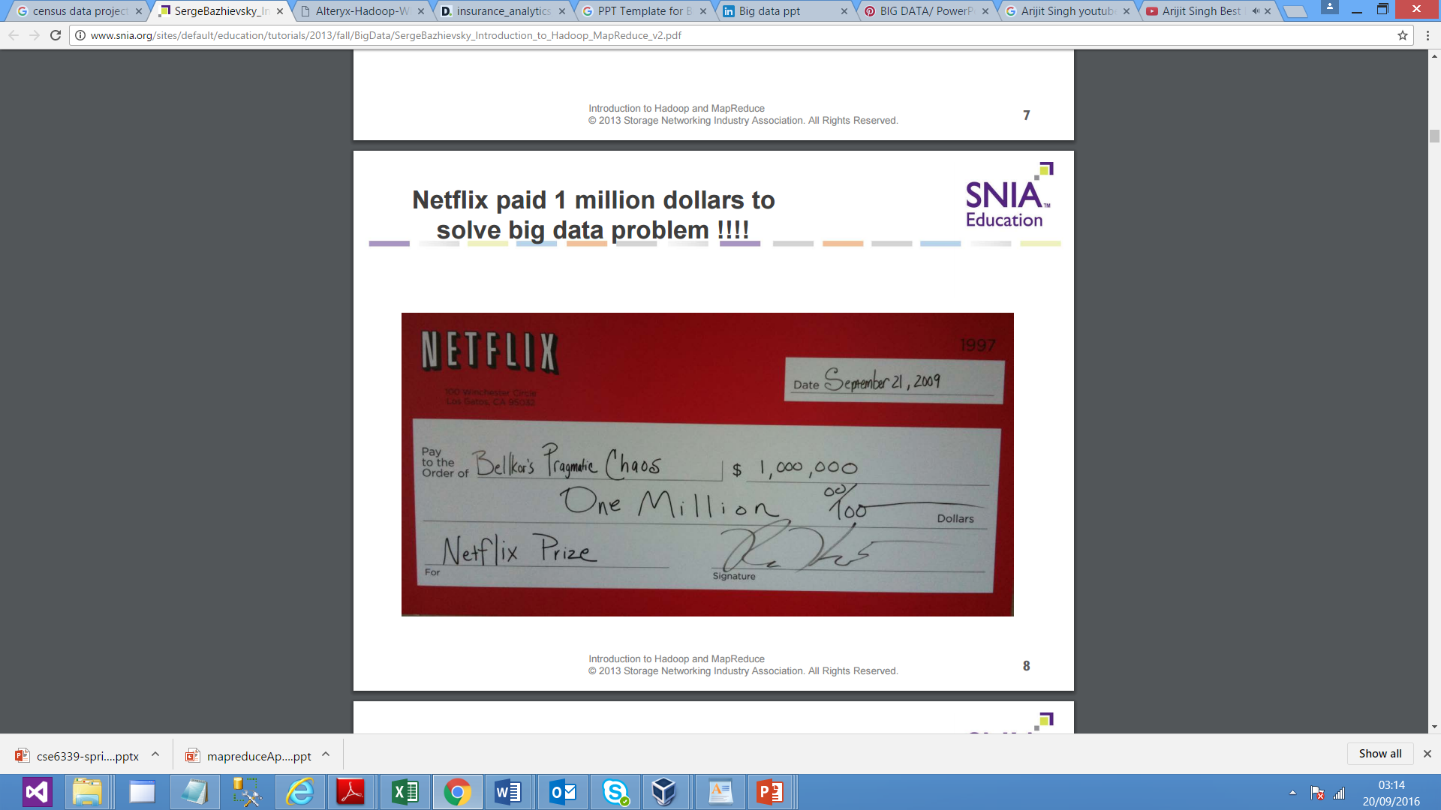
Importance of Big Data Solutions

Slide 9
Project Outline
Title | Census Data Analysis Using BigData Hadoop
Inputs | Raw Census Data in JSON format & supporting Data Table
Data Elements | Age, Education, Marital Status, Gender, TaxFiler Status, Income, Parents, Country of Birth, Citizenship, WeeksWorked
Analysis Relevance | Educational , Social, Financial and Planning
Purpose | To help various organizations including government in reforming the life of citizens by launching various schemes related with Education, Social, Economical. It will also help the planning commission.
Methodology | SCRUM and Agile

Slide 10
Project Outline Cont..
In this project we are aims at using the Hadoop ecosystem to Analyse a Census Data. The data is accepted from user based upon their choice. The raw data is provided in the form of Json logs. Supporting data is also maintained using MySQL database. The Hadoop Ecosystem is used to work upon the big data extracted from the Json log files and MySQL database together and extract substantial amount of information like the country’s Literacy Rate, Orphan percentage, Average Income, Taxpayers details, Male & Female Ratio.
The complete process includes data import from server logs to HDFS using Flume and cleaning up of this data using Hive. Also master data for age group mapping will be downloaded using Sqoop from MySQL. The final steps would be generating reports using core MapReduce jobs using Distributed Cache and Map-Side / Reduce-Side Join, PIG Latin design pattern.

Slide 11
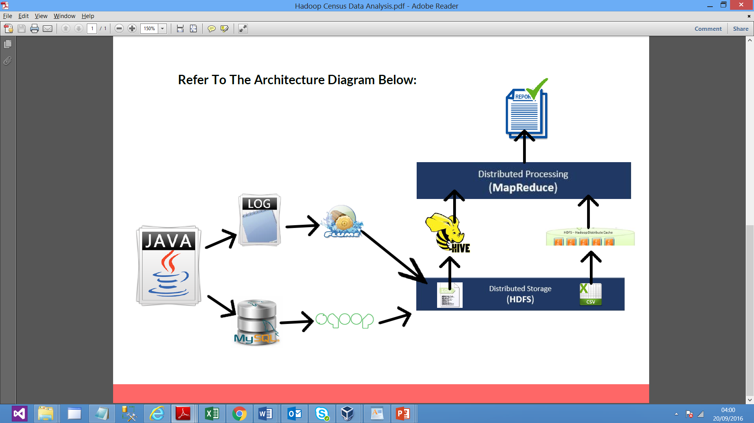
Architectural Diagram

Slide 12
Hardware & software Requirement
Hardware :-
8 GB Ram
Quad Core Processor
100 GB HD
Software :-
Virtual Box
Ubuntu & Cloudera virtual .ova file
Hadoop , HDFS, PIG, Hive, Scoop, Flume, MySQL, Java, TomCat

Slide 13
Job 1 : Educational Analysis
Task 1 : Calculate :
Education Qualification Count : Sub-grouped by Gender
Education Qualification Count based on Employment
Calculate Sex Ratio (Male : Female)
No Supporting Table Required

Slide 14
Job 1 : Educational Analysis
Final Output
Task1
( Children, Male,228)
( Children, Female,224)
( 9th grade, Male,27)
Task2
( 9th grade,25)
( 10th grade,37)
( 11th grade,42)
( 5th or 6th grade,12)
Task3
( Male,939)
( Female,1061)

Slide 15
Job 2 : Financial Analysis
Task 1 : Calculate :
Tax based Income Generated
Total Income Generated , Gender wise Total Income Generated
Total Tax Payers
Total Tax to be collected
Per Capita Income Analysis
Per Capita Income
Age Group wise Per Capita Income
Gender wise Per Capita Income
Supporting Tables Required :
Column Name | Column Type | Remarks
Gender | Varchar | Store gender info
minincome | int | Stores min salary of a salary slab
maxincome | int | Stores max salary of a salary slab
taxper | double | Tax (%) for a salary slab

Slide 16
Job 2 : Financial Analysis
Final Output
Task1
(1728.2616350000017)
Task2
(adult,1828.8573029045647)
(elderly,1822.1314705882355)
(infants,1632.2484130982368)
(Teenager,1758.8825362318848)
(middle-aged,1671.9536820083677)
(senior citizen,1662.542173913042)
Task3
( Male,1792.9552289669857)
( Female,1671.0068897266733)

Slide 17
Job 3 : Social Analysis
Task 1 : Calculate :
Pension Amount to be added after x years
No. of Orphans for each category based on Parents Present
No. of Employable Female Citizens who are Widows or Divorced
Supporting Tables Required :
Pension_Mapping Table:
Orphan_Mapping Table:
Column Name | Column Type | Remarks
oid | int | Primary Key
parent_present | varchar | Status of Parents present
subsidy | int | Subsidy amount paid to orphan
Column Name | Column Type | Remarks
Pid | int | Primary Key
min_income | int | Stores min salary of a salary slab
max_income | int | Stores max salary of a salary slab
pension | int | Pension amount paid

Slide 18
Job 3 : Social Analysis
Final Output
Task1
Total Pension Amount
Task2
( Not in universe,1472)
( Father only present,17)
( Mother only present,133)
( Neither parent present,18)
Task2
( Widowed,75)
( Divorced,70)

Slide 19
Job 4 : Planning Analysis
Task 1 : Calculate :
No. of Voters to get added in next X years
No. of Senior Citizen to get added in next X years
Sex Ratio
Citizen vs. Immigrants Ratio for all Employed

Slide 20
Job 4 : Planning Analysis
Final Output
Task1
1548
Task2
606
Task3
( Male,939)
( Female,1061)
Task4
(135,1865)

Slide 21


Slide 22
Conclusion and Acknowledgment
At the last I would like to say that this presentation focuses on complete learning of Hadoop Eco-System tools and their implementation in the form of project work. Various components of Hadoop-Ecosystem is used here to achieve various objectives like MapReduce, PIG, HIVE, MySQL, etc..
I would like to thank Mr. Abhishek and Mr. Amit for providing complete learning on Big-Data and Hadoop Eco-System products and his guidance towards completing the projects.
I want to also thank Mrs. Bharati B, Mrs. Deepti and Mr. Narender Singh for arranging this type high-end technological training and providing all support to make it successful.

Slide 23


